Slide 1




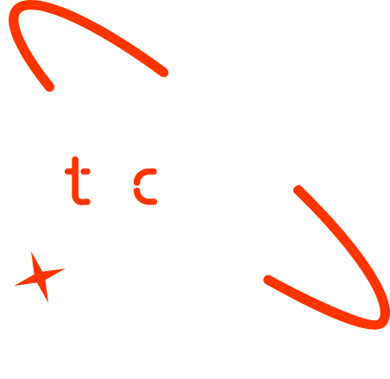

Data-Driven Crop Yield Prediction:
Integrating Environmental Factors
Graduate Name- Lielina Akele Yenealem
Date-6/16/2025

Slide 2

Outline
Concept note and implementation plan
Background
Objectives
SDG Relation
Data
Data Collection
Exploratory Data Analysis et Feature Engineering
Model
Model Selection and Training
Model Evaluation and Hyperparameter Tuning
Model Refinement and Testing
Results
Evaluation Results
Deployment
Future Work

Slide 3
Concept note and Implementation Plan
Notes:
FTs like precision agriculture, remote sensing & AI-powered forming equipment can help increase agricultural productivity in LDCs. This can improve fiid security & contribute to the achievement of SDG 2 (Zero Hunger).

Slide 4
Background
Ethiopia’s economy: Agriculture contributes >30% to GDP, employs >70% of workforce.
Challenges: Unpredictable rainfall, temperature, humidity affect wheat yields.
Motivation: Modernize Ethiopian agriculture with data-driven solutions.
Importance: Accurate yield prediction aids farmers, policymakers, and food security.
Notes:
FTs like precision agriculture, remote sensing & AI-powered forming equipment can help increase agricultural productivity in LDCs. This can improve fiid security & contribute to the achievement of SDG 2 (Zero Hunger).

Slide 5
Objectives
General Objective:
Develop a machine learning model to predict wheat yields using environmental parameters.
Specific Objectives:
Train predictive model with high accuracy using historical and real-time data.
Provide actionable insights for farmers and policymakers. Tailor model to Ethiopia’s climatic variability.
Address gaps in ML applications for Ethiopian agriculture.
Notes:
FTs like precision agriculture, remote sensing & AI-powered forming equipment can help increase agricultural productivity in LDCs. This can improve fiid security & contribute to the achievement of SDG 2 (Zero Hunger).

Slide 6
SDG Relation
SDG 2 – Zero Hunger
Enhances food security by accurately predicting crop yields.
Supports efficient planning for food production and distribution.
Assists farmers and policymakers in making data-driven decisions.
Add your SDG image here
Notes:
FTs like precision agriculture, remote sensing & AI-powered forming equipment can help increase agricultural productivity in LDCs. This can improve fiid security & contribute to the achievement of SDG 2 (Zero Hunger).

Slide 7
SDG Relation
SDG 9 – Industry, Innovation, and Infrastructure
Leverages machine learning and AI to modernize agriculture.
Contributes to innovation in agri-tech solutions.
Add your SDG image here
Notes:
FTs like precision agriculture, remote sensing & AI-powered forming equipment can help increase agricultural productivity in LDCs. This can improve fiid security & contribute to the achievement of SDG 2 (Zero Hunger).

Slide 8
Data
Notes:
FTs like precision agriculture, remote sensing & AI-powered forming equipment can help increase agricultural productivity in LDCs. This can improve fiid security & contribute to the achievement of SDG 2 (Zero Hunger).

Slide 9
Data Collection
oSources:
Ethiopian Institute of Agricultural Research: Yearly wheat yield (20002023).
Ethiopian Meteorological Institute: Environmental data (20092023).
Features: Elevation, humidity, temperature, precipitation, sunshine hours, wind speed.
Challenge: Limited data size; synthetic data generated to augment dataset.
pian Institute of Agricultural Research: Yearly wheat yield (20002023).
Ethiopian Meteorological Institute: Environmental data (20092023).
Features: Elevation, humidity, temperature, precipitation, sunshine hours, wind speed.
Challenge: Limited data size; synthetic data generated to augment dataset.
Notes:
FTs like precision agriculture, remote sensing & AI-powered forming equipment can help increase agricultural productivity in LDCs. This can improve fiid security & contribute to the achievement of SDG 2 (Zero Hunger).

Slide 10
Exploratory Data Analysis and Feature Engineering
Steps:
Data cleaning: Handle missing values, restructure datasets. Outlier detection: IQR method, capping extreme values.
Normalization: Min-Max scaling to [0,1] range.
Visualizations: Boxplots, histograms, correlation heatmaps.
Notes:
FTs like precision agriculture, remote sensing & AI-powered forming equipment can help increase agricultural productivity in LDCs. This can improve fiid security & contribute to the achievement of SDG 2 (Zero Hunger).

Slide 11
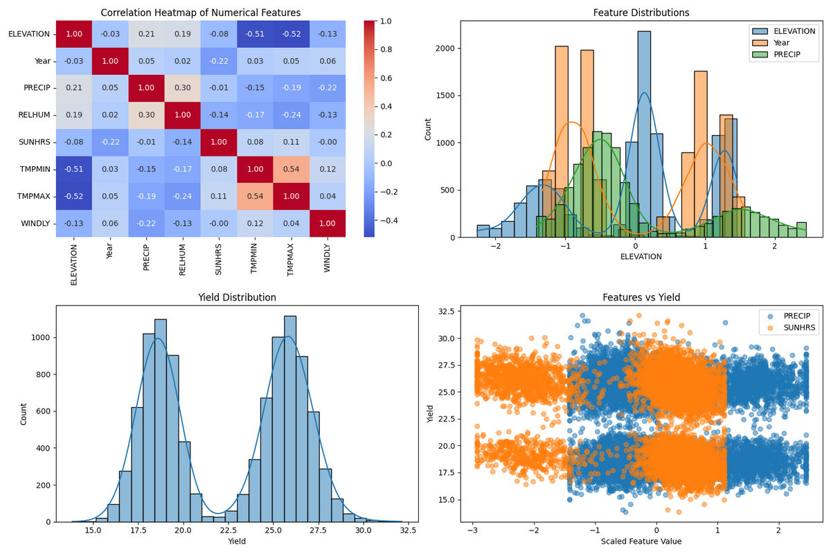
Exploratory Data Analysis and Feature Engineering
Notes:
FTs like precision agriculture, remote sensing & AI-powered forming equipment can help increase agricultural productivity in LDCs. This can improve fiid security & contribute to the achievement of SDG 2 (Zero Hunger).

Slide 12
Model
Notes:
FTs like precision agriculture, remote sensing & AI-powered forming equipment can help increase agricultural productivity in LDCs. This can improve fiid security & contribute to the achievement of SDG 2 (Zero Hunger).

Slide 13
Model Selection and Training
Models tested: Linear Regression, Random Forest, Gradient Boosting, KNN, SVR, CNN.
Traditional Models:
Linear Regression: Baseline, assumes linear relationships.
Random Forest, Gradient Boosting: Capture non-linear patterns. KNN, SVR: Tested for local and kernel-based predictions.
CNN:
Sequential model with dense layers, ReLU activation.
Tuned via Keras Hyperband (units, dropout, learning rate).
Notes:
FTs like precision agriculture, remote sensing & AI-powered forming equipment can help increase agricultural productivity in LDCs. This can improve fiid security & contribute to the achievement of SDG 2 (Zero Hunger).

Slide 14
Model Evaluation and Hyperparameter Tuning
Hyperparameter tuning: GridSearchCV for RF, GB, KNN, SVR; Keras Tuner for CNN.
Train-test split: 80/20, random state 42. Metrics: RMSE, MAE, R².
Notes:
FTs like precision agriculture, remote sensing & AI-powered forming equipment can help increase agricultural productivity in LDCs. This can improve fiid security & contribute to the achievement of SDG 2 (Zero Hunger).

Slide 15
Model Refinement and Testing
Metrics: RMSE, MAE, R² score.
Notes:
FTs like precision agriculture, remote sensing & AI-powered forming equipment can help increase agricultural productivity in LDCs. This can improve fiid security & contribute to the achievement of SDG 2 (Zero Hunger).

Slide 16
Results
Notes:
FTs like precision agriculture, remote sensing & AI-powered forming equipment can help increase agricultural productivity in LDCs. This can improve fiid security & contribute to the achievement of SDG 2 (Zero Hunger).

Slide 17
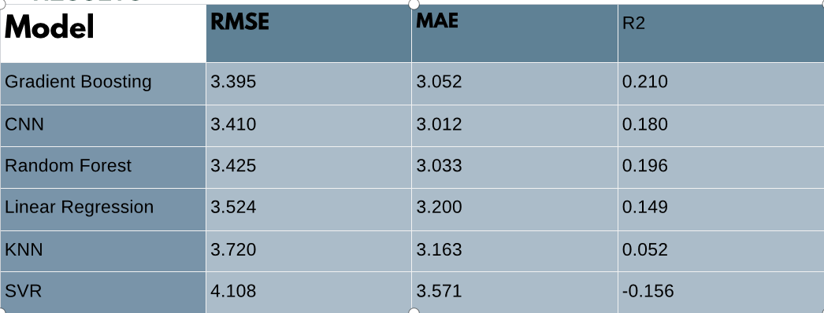
Evaluation Results
Notes:
FTs like precision agriculture, remote sensing & AI-powered forming equipment can help increase agricultural productivity in LDCs. This can improve fiid security & contribute to the achievement of SDG 2 (Zero Hunger).

Slide 18
Deployment
NOT DEPLOYED IN OUR CASE
Notes:
FTs like precision agriculture, remote sensing & AI-powered forming equipment can help increase agricultural productivity in LDCs. This can improve fiid security & contribute to the achievement of SDG 2 (Zero Hunger).

Slide 19
Future Work
Collaborate with EIAR, EMI for richer datasets. Deploy on cloud platforms (e.g., AWS).
Expand to other crops and regions.
Enhance model interpretability for stakeholders.
Notes:
FTs like precision agriculture, remote sensing & AI-powered forming equipment can help increase agricultural productivity in LDCs. This can improve fiid security & contribute to the achievement of SDG 2 (Zero Hunger).

Slide 20
References
T. van Klompenburg et al., "Crop yield prediction using machine learning: A systematic literature review," Computers and Electronics in Agriculture, 2020.
S. Khaki et al., "Crop yield prediction integrating genotype and weather variables using deep learning," PLoS ONE, 2021.
H. Zhang et al., "Progress in research on deep learning-based crop yield prediction," Agronomy, 2024.
Notes:
FTs like precision agriculture, remote sensing & AI-powered forming equipment can help increase agricultural productivity in LDCs. This can improve fiid security & contribute to the achievement of SDG 2 (Zero Hunger).

Slide 21


Thank you!

